Slide 1

Foot Traffic and Dwell Time Trends at Office Supply Stores During the Remote Work Shift
Analyzing customer behavior changes amid remote work adoption
Notes:
AI-generated content may be incorrect. ---

Slide 2
Introduction
Notes:
--- This slide references information from the following file: https://purdue0-my.sharepoint.com/personal/rsana_purdue_edu/_layouts/15/Doc.aspx?sourcedoc=%7BCB5F538E-AD73-4F91-A8F8-8F5817F554D1%7D&file=Group%207_Status_Report%20copy_deck%20reference.docx&action=default&mobileredirect=true Context and Objectives

Slide 3
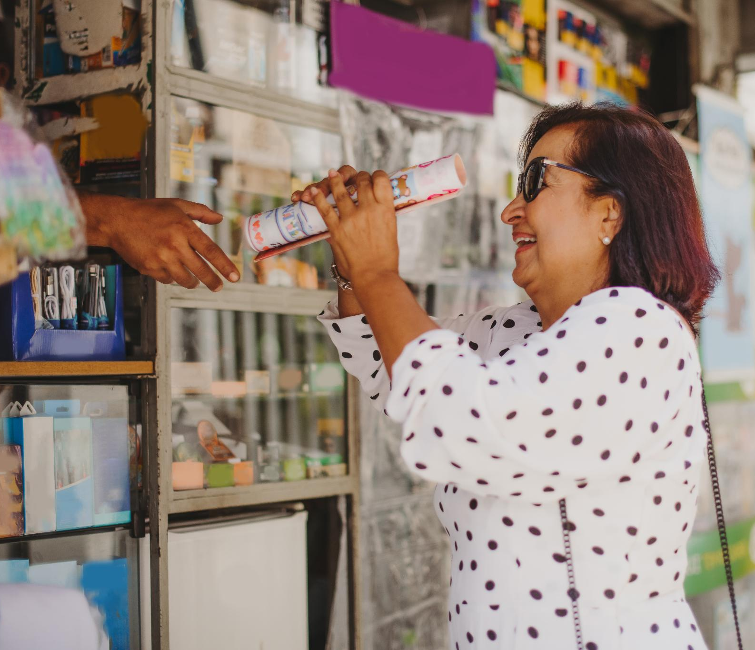
Context and Objectives
Remote Work Impact
The shift to remote work in early 2020 significantly influenced consumer behavior at office supply stores.
Demographic Segmentation
Study segments counties by urban, suburban, and rural areas to analyze store foot traffic and dwell time trends.
Data-Driven Insights
Utilizing SafeGraph and RUCA data helps understand how different demographics affect store engagement.
Strategic Objectives
Insights aim to inform retail strategies and community service expansions post-pandemic.
Notes:
--- This slide references information from the following file: https://purdue0-my.sharepoint.com/personal/rsana_purdue_edu/_layouts/15/Doc.aspx?sourcedoc=%7BCB5F538E-AD73-4F91-A8F8-8F5817F554D1%7D&file=Group%207_Status_Report%20copy_deck%20reference.docx&action=default&mobileredirect=true This presentation explores the impact of the remote work shift during early 2020 on consumer behavior at office supply stores. The study focuses on foot traffic and dwell time trends across various counties in California, segmented by urban, suburban, and rural classifications. Using data from SafeGraph and RUCA codes, the analysis aims to understand how different demographics—such as K–12 households, working-age populations, and education levels—shaped store engagement. The objective is to uncover insights that can inform retail strategies and community service expansions in the post-pandemic landscape.

Slide 4
Research Question 1
Notes:
--- This slide references information from the following file: https://purdue0-my.sharepoint.com/personal/rsana_purdue_edu/_layouts/15/Doc.aspx?sourcedoc=%7BCB5F538E-AD73-4F91-A8F8-8F5817F554D1%7D&file=Group%207_Status_Report%20copy_deck%20reference.docx&action=default&mobileredirect=true Foot Traffic and Demographic Influences

Slide 5
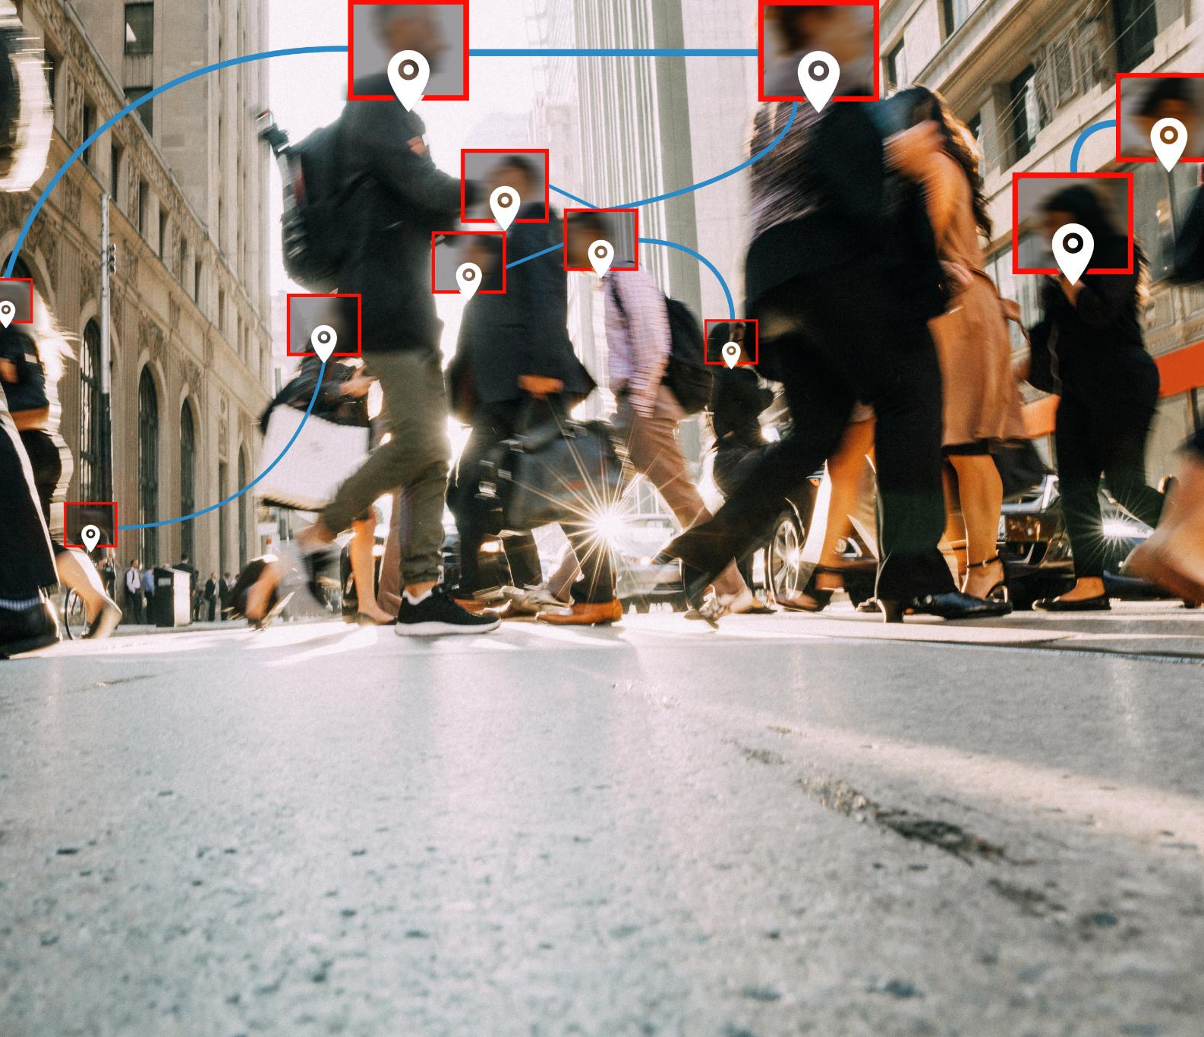
Foot Traffic and Demographic Influences
Foot Traffic Trends
Foot traffic peaked early 2020, fell sharply during lockdowns, then rebounded at major office supply stores.
Shopping Behavior by Store Type
Specialty stores had fewer visits but longer dwell times, indicating focused and high-intent customers.
Demographic Impact on Visits
Suburban family areas showed increased visits, while urban shoppers preferred quick, goal-oriented trips.
Education and Dwell Times
Regions with higher education levels experienced longer store visits, reflecting preference for personalized shopping.
Notes:
--- This slide references information from the following file: https://purdue0-my.sharepoint.com/personal/rsana_purdue_edu/_layouts/15/Doc.aspx?sourcedoc=%7BCB5F538E-AD73-4F91-A8F8-8F5817F554D1%7D&file=Group%207_Status_Report%20copy_deck%20reference.docx&action=default&mobileredirect=true During the first four months of 2020, foot traffic at office supply stores peaked in January and February, followed by a sharp decline in mid-March (Week 12) due to pandemic lockdowns. Staples demonstrated a notable rebound in Week 17, reaching nearly 98,000 visits, indicating a resurgence in demand for home-office supplies. Specialty stores such as Papyrus and Rapid Refill experienced fewer visits but significantly longer dwell times, suggesting high-intent, focused shopping behavior. Demographic factors played a crucial role: areas with higher concentrations of K–12 households and working-age populations showed distinct engagement patterns. For instance, suburban regions with family-oriented demographics saw increased visits, while urban areas exhibited quicker, goal-oriented trips. Additionally, regions with higher education levels correlated with longer dwell times, reflecting a preference for personalized and boutique-style shopping experiences.

Slide 6
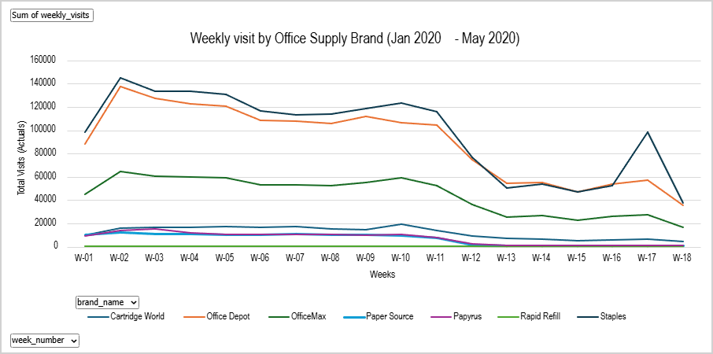
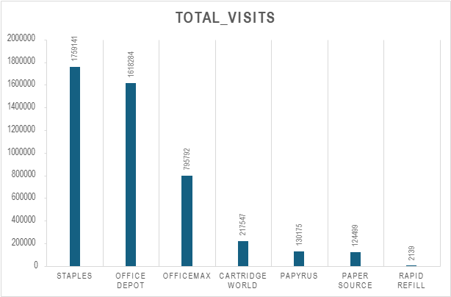
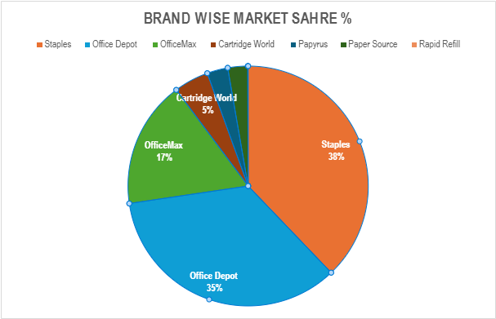
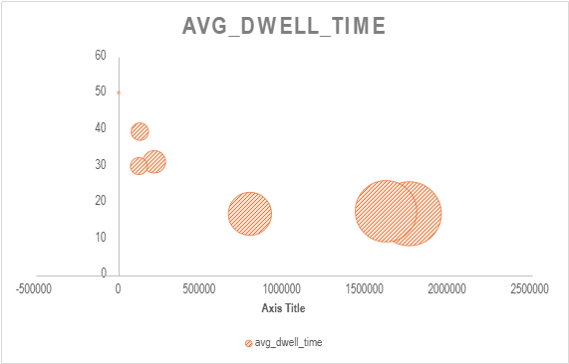

Slide 7
Research Question 2
Notes:
--- This slide references information from the following file: https://purdue0-my.sharepoint.com/personal/rsana_purdue_edu/_layouts/15/Doc.aspx?sourcedoc=%7BCB5F538E-AD73-4F91-A8F8-8F5817F554D1%7D&file=Group%207_Status_Report%20copy_deck%20reference.docx&action=default&mobileredirect=true Suburban vs Urban Recovery Patterns

Slide 8

Suburban vs Urban Recovery Patterns
Suburban Recovery Strength
Suburban counties showed the strongest recovery in foot traffic and dwell time driven by office supply stores like Staples and Office Depot.
Urban Shopping Behavior
Urban centers had slightly fewer visits but maintained similar dwell times, reflecting efficient and purpose-driven shopping habits.
Rural Visit Patterns
Rural areas experienced fewer visits but longer dwell times, indicating more deliberate and extended shopping approaches.
Regional Dynamics Importance
Los Angeles County was a hotspot for office supply demand, highlighting significant regional variations in recovery patterns.
Notes:
--- This slide references information from the following file: https://purdue0-my.sharepoint.com/personal/rsana_purdue_edu/_layouts/15/Doc.aspx?sourcedoc=%7BCB5F538E-AD73-4F91-A8F8-8F5817F554D1%7D&file=Group%207_Status_Report%20copy_deck%20reference.docx&action=default&mobileredirect=true Suburban counties demonstrated the strongest recovery in foot traffic and dwell time during the early remote work shift. Staples and Office Depot led this resurgence, benefiting from their strong presence in suburban areas. Urban centers, while showing slightly lower visit counts, maintained similar dwell times, indicating efficient, purpose-driven shopping. Rural areas, on the other hand, experienced fewer visits but longer dwell durations, suggesting a more deliberate shopping approach. Notably, Los Angeles County emerged as a hotspot for office supply demand, underscoring the importance of regional dynamics. These patterns highlight how suburban consumers quickly adapted to remote work needs, driving early in-store recovery and influencing post-pandemic retail strategies.

Slide 9
Research Question 3
Notes:
--- This slide references information from the following file: https://purdue0-my.sharepoint.com/personal/rsana_purdue_edu/_layouts/15/Doc.aspx?sourcedoc=%7BCB5F538E-AD73-4F91-A8F8-8F5817F554D1%7D&file=Group%207_Status_Report%20copy_deck%20reference.docx&action=default&mobileredirect=true Brand Stabilization and Loyalty

Slide 10
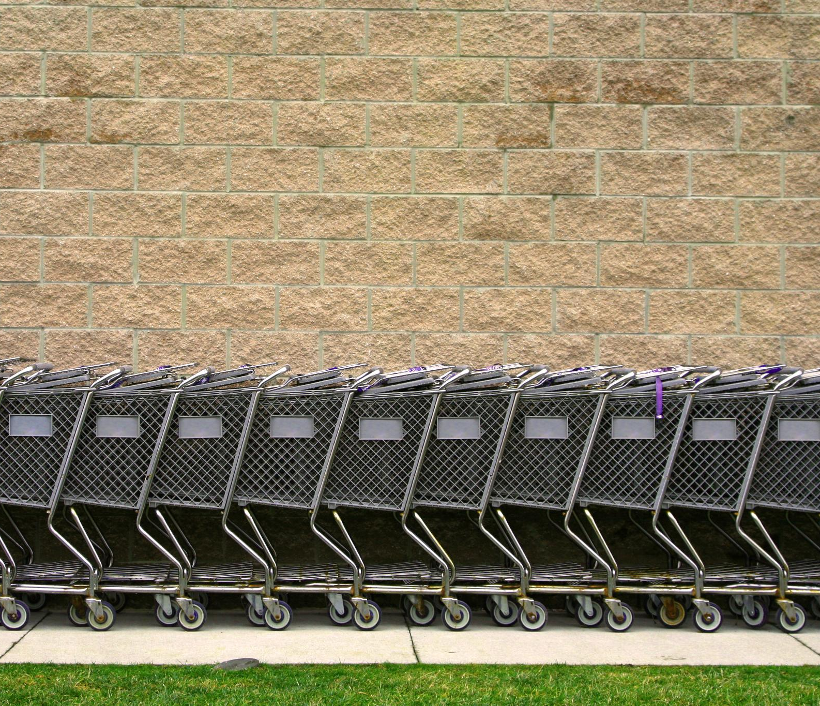
Brand Stabilization and Loyalty
Early Brand Stabilization
Staples and Office Depot showed early recovery in visits and dwell times, highlighting strong consumer loyalty.
Divergent Recovery Paths
Office Depot’s steady recovery contrasted with OfficeMax’s lag, reflecting brand overlap and diluted traffic.
Niche Brand Engagement
Specialty brands had low traffic but high dwell times, indicating deep engagement from niche audiences.
Role of Essential Status
Essential status and reliable supply chains influenced consumer behavior and brand trust during reopening.
Notes:
--- This slide references information from the following file: https://purdue0-my.sharepoint.com/personal/rsana_purdue_edu/_layouts/15/Doc.aspx?sourcedoc=%7BCB5F538E-AD73-4F91-A8F8-8F5817F554D1%7D&file=Group%207_Status_Report%20copy_deck%20reference.docx&action=default&mobileredirect=true Staples and Office Depot exhibited early stabilization in both visits and dwell times, with Staples rebounding rapidly by Week 17. This quick recovery suggests strong brand loyalty and a perception of these stores as essential retailers during the remote work transition. Office Depot followed a steady recovery path, while OfficeMax lagged behind, possibly due to brand overlap and diluted traffic. Specialty brands like Papyrus and Rapid Refill maintained low traffic but high dwell times, indicating deep engagement from a niche audience. These trends reveal that essential status and reliable supply chains played a critical role in consumer behavior, with customers returning to trusted brands as soon as stores reopened.

Slide 11
Conclusion
Notes:
--- This slide references information from the following file: https://purdue0-my.sharepoint.com/personal/rsana_purdue_edu/_layouts/15/Doc.aspx?sourcedoc=%7BCB5F538E-AD73-4F91-A8F8-8F5817F554D1%7D&file=Group%207_Status_Report%20copy_deck%20reference.docx&action=default&mobileredirect=true Summary of Insights and Implications

Slide 12

Summary of Insights and Implications
Suburban Consumer Adaptation
Suburban consumers quickly adapted to remote work, boosting early recovery in office supply retail sectors.
Leading Retailers
Staples and Office Depot led recovery due to essential status and strong customer loyalty in the market.
Demographic Influence on Behavior
Education, household makeup, and working-age density shaped consumer shopping behavior and preferences.
Retail Strategy Implications
Retailers can tailor store formats and products to meet varied consumer needs in a post-pandemic world.
Notes:
--- This slide references information from the following file: https://purdue0-my.sharepoint.com/personal/rsana_purdue_edu/_layouts/15/Doc.aspx?sourcedoc=%7BCB5F538E-AD73-4F91-A8F8-8F5817F554D1%7D&file=Group%207_Status_Report%20copy_deck%20reference.docx&action=default&mobileredirect=true The analysis confirms that suburban consumers adapted more swiftly to remote work demands, driving early recovery in office supply retail. Staples and Office Depot emerged as leaders due to their essential status and strong customer loyalty. Demographic factors such as education level, household composition, and working-age density significantly influenced shopping behavior, creating a divide between efficiency-driven and experience-driven consumers. Retailers can leverage these insights to tailor store formats, product offerings, and community services to better meet the needs of diverse consumer segments in a post-pandemic environment.

